Slide 1
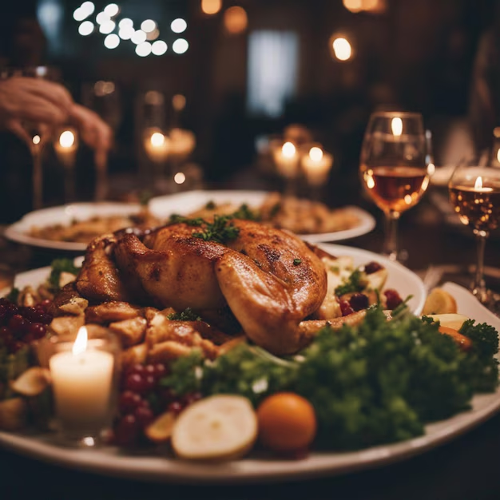

Smarter Kitchen Planning: How Much to Cook with Confidence
Predicting Tomorrow’s Needs - Today

Slide 2
Why This Project?
📌 The Challenge in Hotel Kitchens
Daily food demand is unpredictable — leading to frequent overcooking or undercooking
Overcooking causes: → Food waste → Increased costs → Poor inventory control
Undercooking results in: → Missed guest orders → Lower customer satisfaction → Stress on kitchen staff
No reliable method to predict how much to prepare for each dish or day

Slide 3
Why This Project?
💡 Why This Problem Matters
Food quantity planning directly impacts profit margins and guest experience
A smarter system is needed to forecast demand using past data, trends, and patterns
Accurate forecasting = Less waste, better planning, and happier customers

Slide 4
Our Goal: Smarter Kitchen Planning with Data
📊 Use past order data to forecast daily food demand
🍛 Identify high-demand dishes in advance to plan better
📅 Predict cooking quantities for the next 30 days with confidence
🗑️ Reduce food waste and cut unnecessary kitchen costs
⚙️ Improve kitchen efficiency and team planning
😊 Enhance guest satisfaction through timely service and availability
📈 Provide clear, easy-to-use dashboards for kitchen and management teams
📅 Past Orders
📊 Forecast
Model
🍲 Demand Predictions
🍽️ Serve Right

Slide 5
What Data We Used
Customer Details
Dishes Ordered
Quantities
Time of Order
(breakfast, lunch, dinner)
Date & Day Info
(Weekdays, weekends, holidays)
Payment Methods
Ingredients List

Slide 6
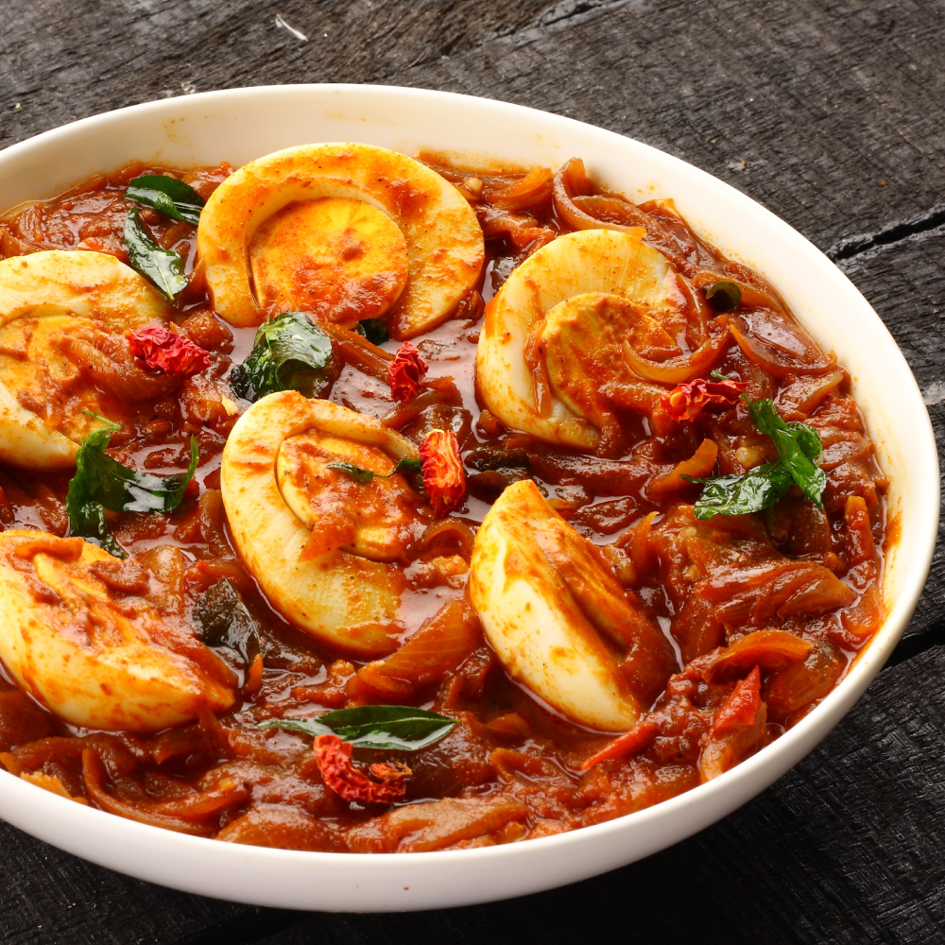

Most Ordered Dishes – What’s Driving the Kitchen?

Slide 7
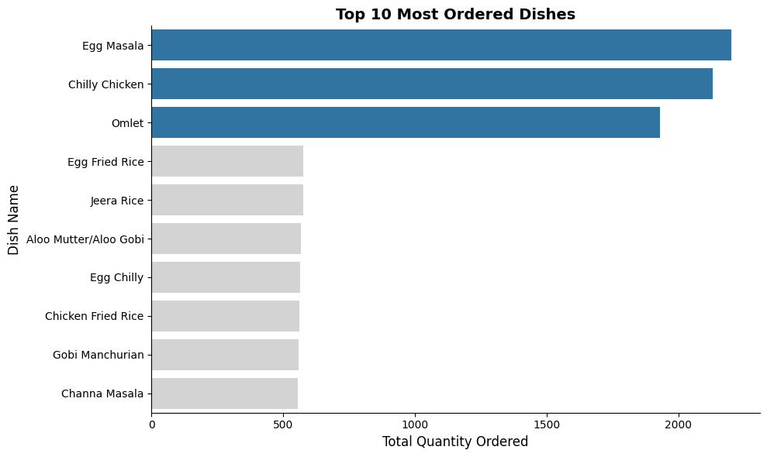
Top 10 Most Ordered Dishes – Key Drivers of Demand
The top 3 dishes : Egg Masala, Chilly Chicken, and Omlet — dominate customer preference.
These 3 dishes alone make up 61.3% of all top 10 orders.
Recommendation:
• Prioritize these items in kitchen prep and stock planning.
• Use them in combo offers or as high-visibility items on the menu.
Top 3 Dishes = 61% of Demand — Big Opportunity

Slide 8
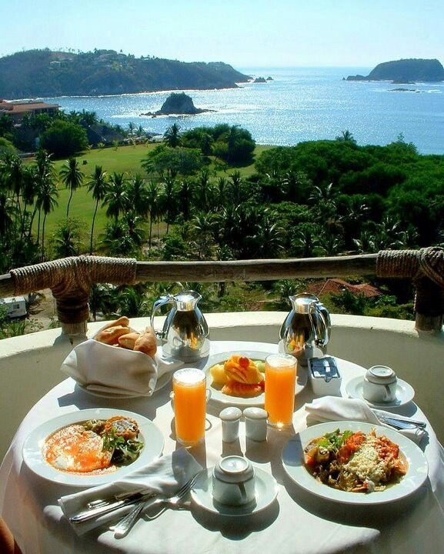
When Are Customers Most Active?

Slide 9
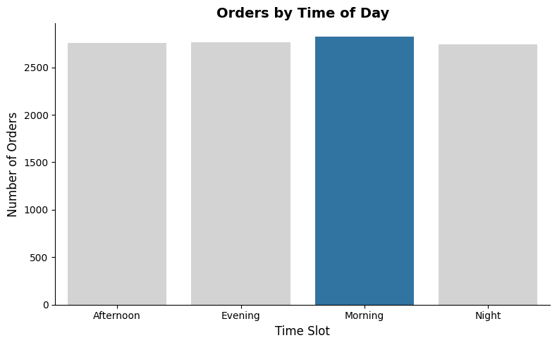
Orders by Time of Day – When Do Customers Eat Most?
Morning has the highest orders
Other time slots show steady demand
Key Takeaway
Prioritize morning prep in the kitchen — both ingredients and staffing
Consider morning combos or loyalty offers to drive even more value

Slide 10
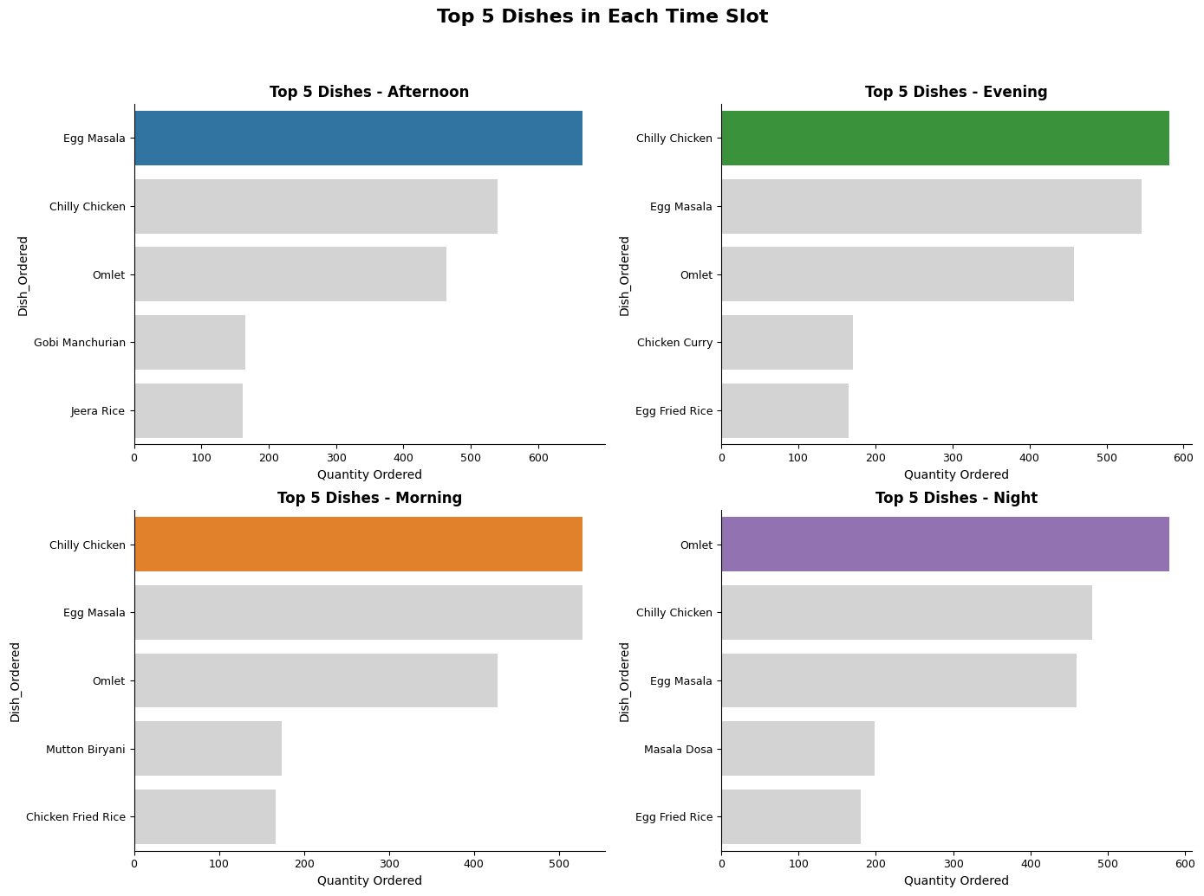
Top Dishes by Time Slot – What to Prep & When
Chilly Chicken, Egg Masala, Omlet dominate across slots
Omlet peaks at night, Chilly Chicken in morning/evening
Action:
Focus prep on top 3 dishes daily
Offer slot-specific combos to boost sales

Slide 11

Which Days People Crave Food the Most?

Slide 12
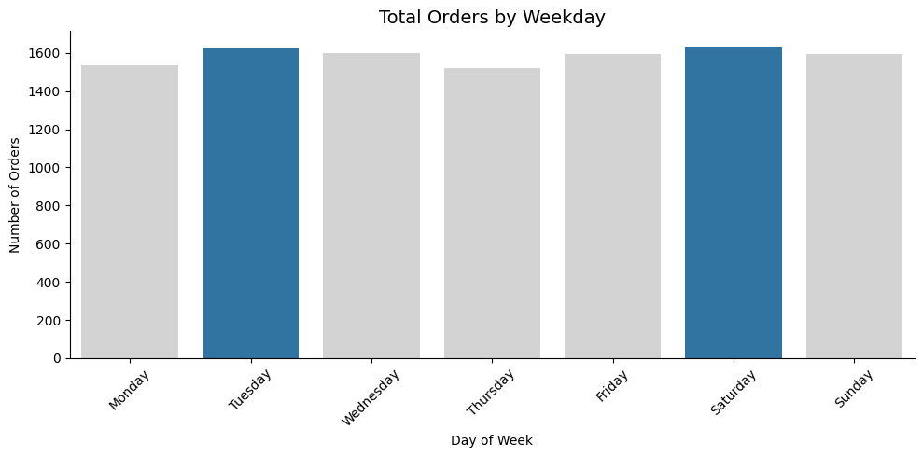
Weekday Order Trends – When Is Demand Highest?
Tuesdays & Saturdays lead in orders — prep more on these days
Launch offers on slower days (e.g., Monday, Thursday) to balance load.

Slide 13
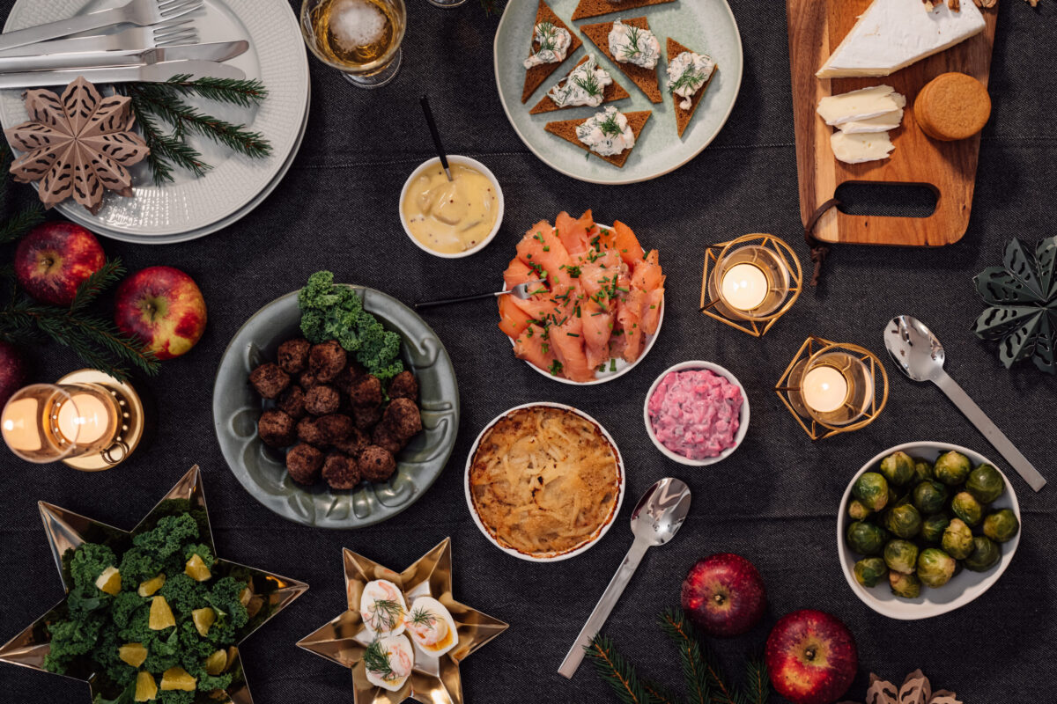
Monthly Ordering Patterns: Peaks vs. Lows

Slide 14
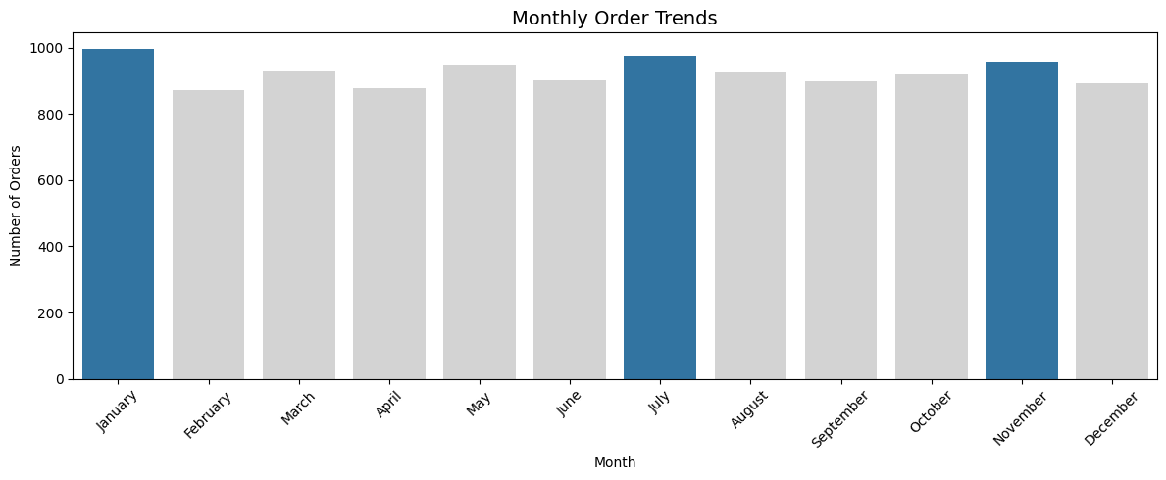
When Demand Rises – A Monthly View
Top Months for Orders: • Jan (~1000) – New Year gatherings • July (~980) – Monsoon comfort food • Nov (~960) – Festive season (Diwali)
🔻 Lowest Month: • Feb (~870) – ~13% lower than peak
Action:
Plan inventory, menus & promotions for peak months
Use quieter periods (like Feb) for cost control & loyalty drives

Slide 15
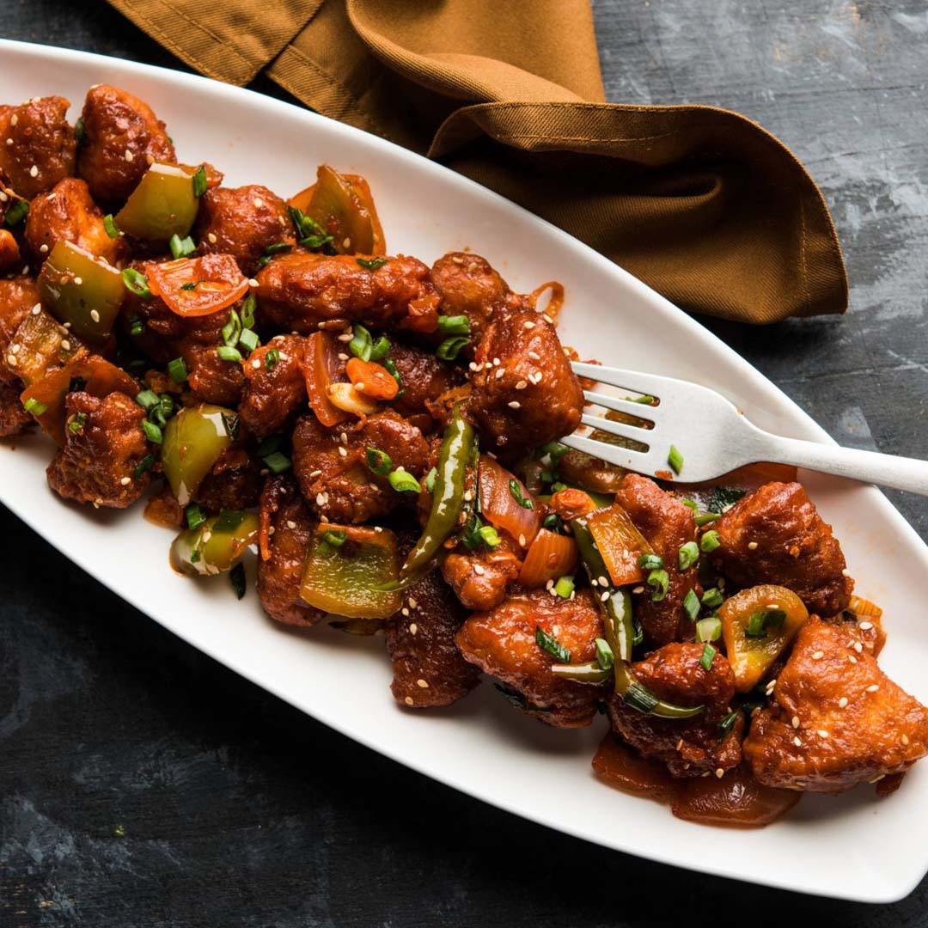
What People Crave on Holidays vs Normal Days

Slide 16
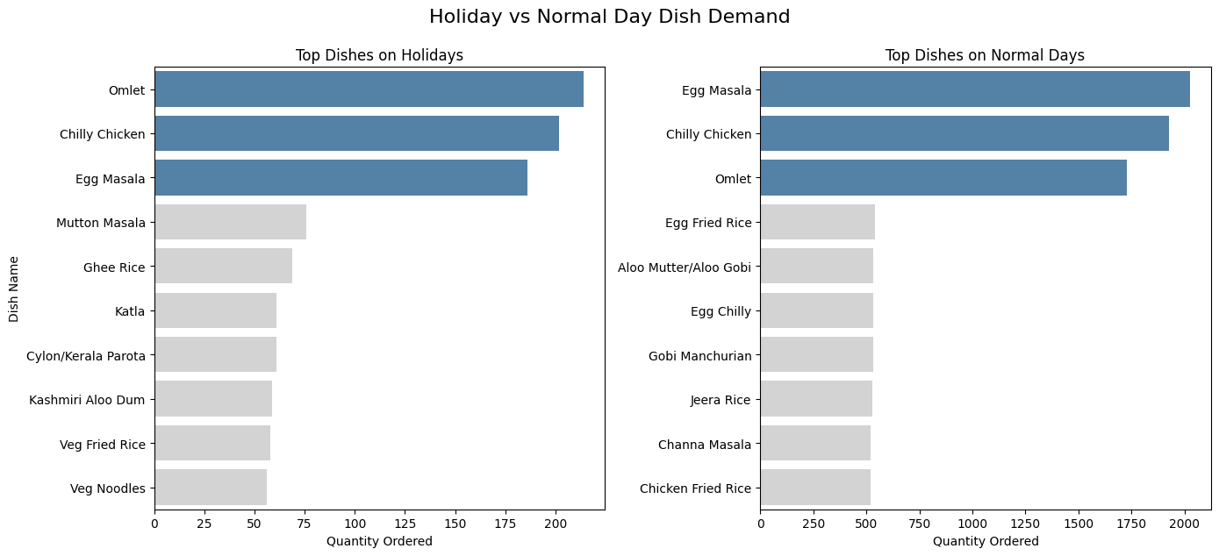
Same favorites, different flavors by day.

Slide 17

Total Demand Forecast - Next 30 Days

Slide 18
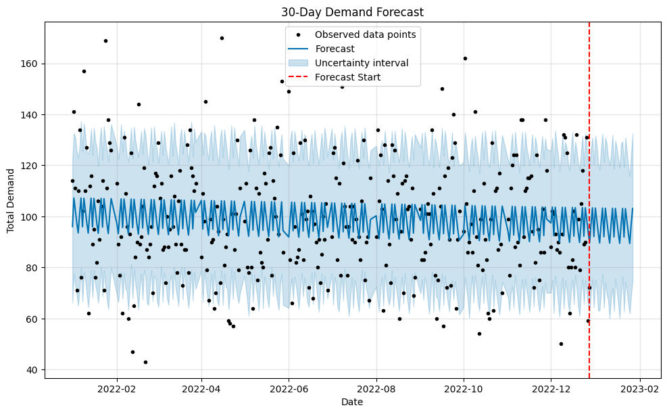
30-Day Demand Forecast

Slide 19
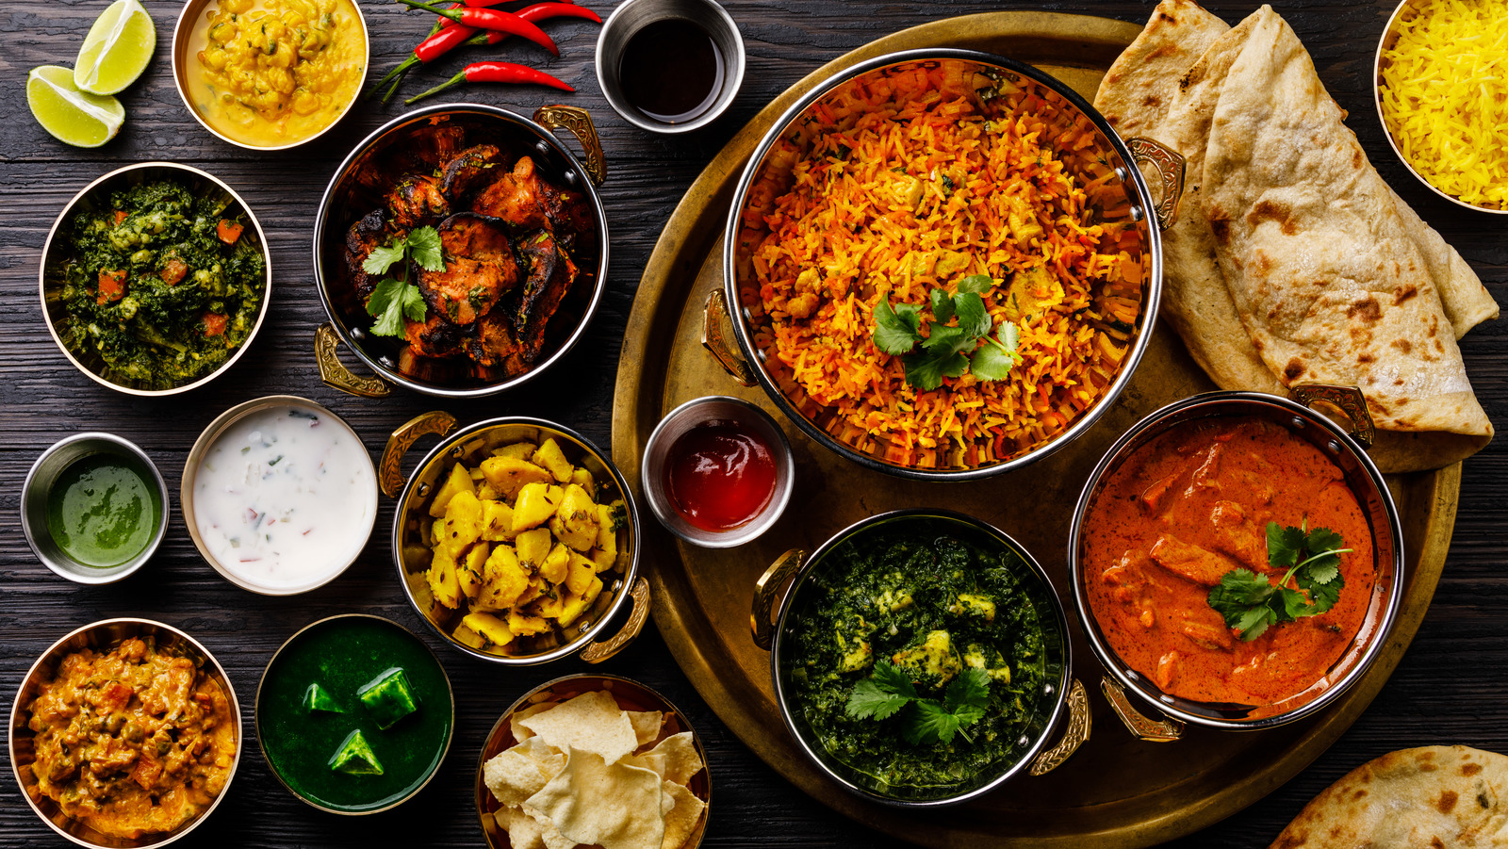
Top Dishes – Forecasted Demand for Next 30 Days

Slide 20
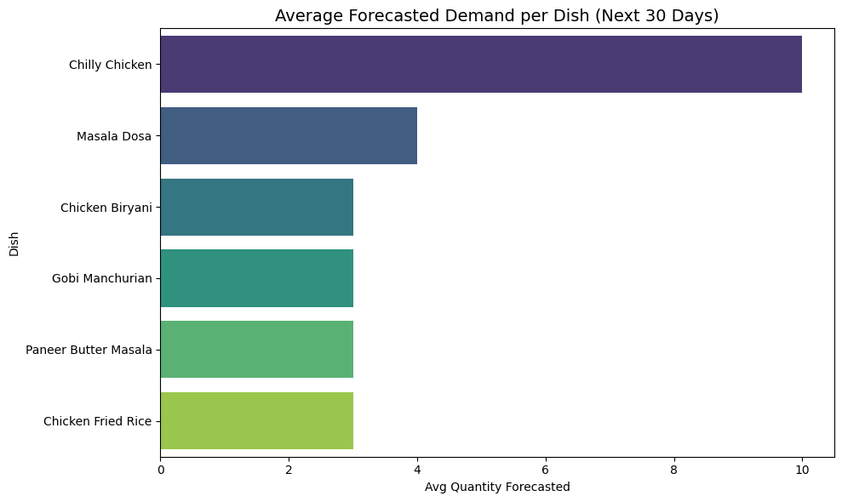
Which items should the kitchen prepare more of?

Slide 21
Key Insights
🥇 Chilly Chicken is forecasted to dominate — with 10+ average orders/day, it's clearly a bestseller.
🥈 Masala Dosa follows, though at less than half the demand of Chilly Chicken.
📊 The next four — Chicken Biryani, Gobi Manchurian, Paneer Butter Masala, and Chicken Fried Rice — have similar demand levels, averaging ~3 orders/day.
Business Takeaways:
Bulk prepare Chilly Chicken — stock ingredients and assign skilled staff accordingly
Optimize prep time for the next 4 dishes — quick turnover can improve service speed
Consider cross-promotions or combo meals around the mid-demand items

Slide 22

Business Impact & Actionable Recommendations

Slide 23
Business Impact
🍽️ Smarter Kitchen Planning — Demand patterns by day, dish, and occasion help optimize stock and reduce food waste
⏰ Efficient Staff Scheduling — Predicting rush periods and top dishes enables better staffing decisions, especially on holidays
💡 Improved Customer Experience — Always having top-requested items ready can reduce wait time and boost satisfaction
📉 Reduced Inventory Loss — Forecasting low-demand dishes avoids overstocking and spoilage

Slide 24
Key Recommendations
Always Stock Evergreen Hits → Ensure Chilly Chicken, Masala Dosa, and Egg Masala are always prepped — they consistently top demand charts.
Holiday vs Normal Day Menus → On holidays, expect demand for heavier meals (e.g., Mutton Masala, Ghee Rice); prep accordingly.
Time-Based Prep Strategy → Use hourly order trends to pre-cook high-demand dishes during peak periods.
Forecast-Driven Ingredient Purchasing → Use the Prophet model output to guide daily/weekly ingredient procurement.
Explore Combo Offers for Mid-Demand Dishes → Boost sales of items like Gobi Manchurian or Paneer Butter Masala by pairing with bestsellers.

Slide 25
THANK YOU

